Slide 1



MINI-PROJECT PRESENTATION ON AIRLINE RESERAVTION SYSTEM
BY
GROUP 1 Dated: 26/02/2018
IGATE is now a part of Capgemini

Slide 2

TEAM MEMBERS
Abhijit Panda
Apurv Agrawal
Laxmi Bhavani
Bijal Majethia
Anabarsi
Ankur Kumar Gupta
Alauddin Abbas
Dhanalakshmi

Slide 3
OUTLINE
Introduction
Basic Structure of Project
Admin
Executive
User
Test Cases
RVFD
Use Case
Defect Report
Conclusion
References

Slide 4
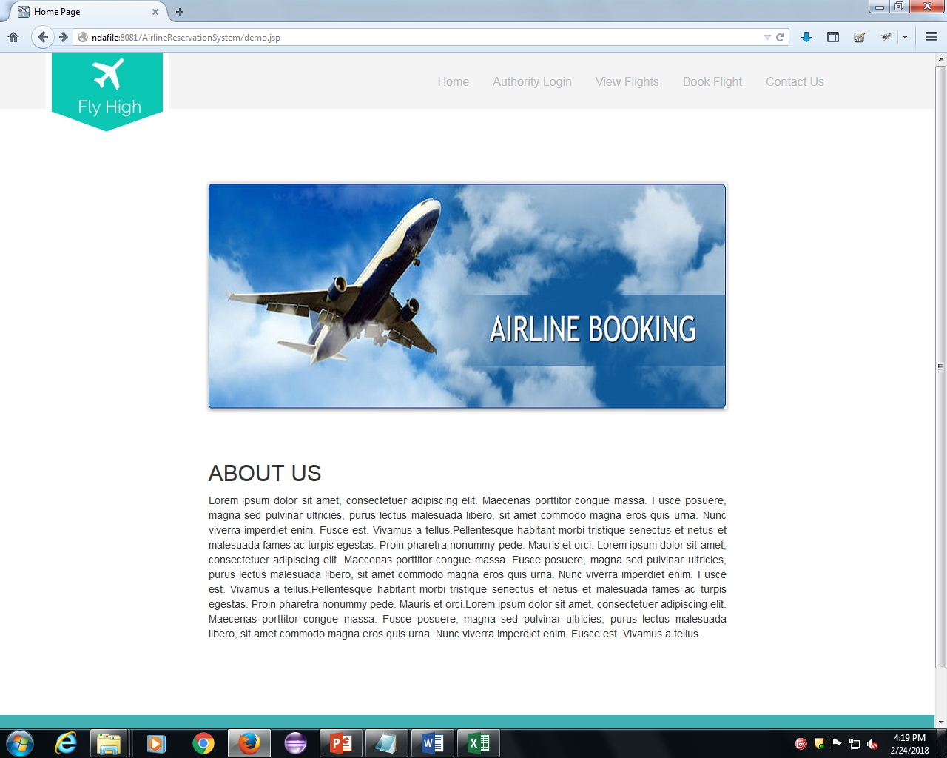
INTRODUCTION
WEBSITE LINK
http://ndafile:8081/AirlineReservationSystem/

Slide 5
INTRODUCTION Cont..
Various function available on the website:-
Authority Login
View Flights
Book Flights
Contact Us

Slide 6
OVERVIEW OF THE PROJECT CONT..
From the Requirement Sheet and Website given:-
Test Cases
RVFD
Defect Report
Use Cases

Slide 7
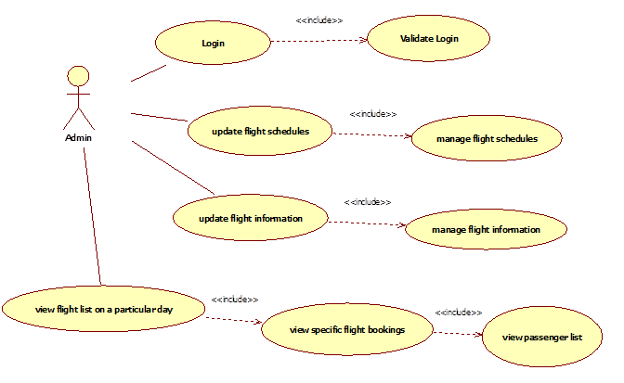
The administrator has the right to keep track of the flight details: Login Update Manage Report
ADMIN

Slide 8
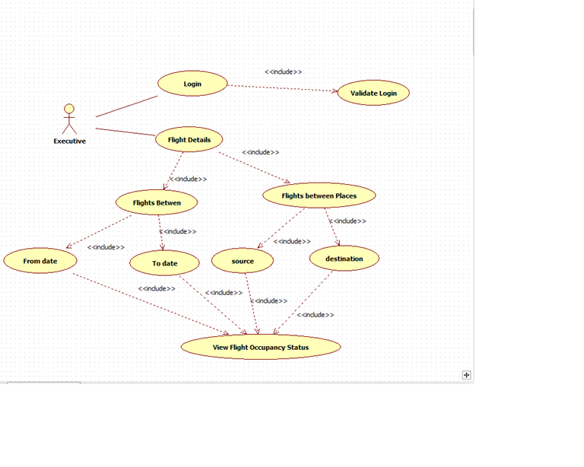
Airline-executive alone will be able to view flight-occupancy - Login - View Details
EXECUTIVE

Slide 9
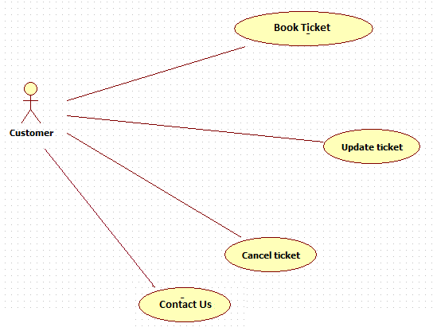
USER
User can reserve a flight ticket and also update or cancel his reservation
-Reserve or Book
-Update
-Cancel
-Contact Us

Slide 10
TEST CASES
Admin
Login
Executive
View Flights
User
Login
Book Flights
View Flights Acc. To Period
View Flights Acc. To Place
Contact

Slide 11
REQUIREMENT ITEMIZATION
Requirement Itemization or RVFD is a technique to separate the requirements into different categories.
This is basically used to simplify the requirements and detect the undetected defects.
The categories of requirements are:

Slide 12
RVFD Cont..
Security
It Involves Login, Logout and Payment
Explicit
It involves the method by which application can be invoked
Invocation
Implicit
It involves all function mention in Requirement sheet
It involves some common function implemented by Developer itself

Slide 13
RVFD Cont..
Termination
It involves the method by which application can be invoked
File Handling
It involve the things that need to be confirmed
System
Error Handling
Query
It involves the system requirements
It involves the storing of files in data base
It involves the possible error

Slide 14
USE CASE
View and Book Flights
Update Flights
Cancel Flights
Executive Login
View Flights based on Period
View Flights based on Place
Admin Login
Update Flight Schedules and Flight info
Generate Various Reports

Slide 15
DEFECT REPORT
What is Defect ?
Error or a bug, in the application which is created.
Flaws in the software are called defects
What is Defect Report ?
The report written for logging these defects

Slide 16
DEFECT REPORT Cont..
Components of a defect report
Defect ID
Defect description
Product version
Date raised
Reported by
Status
Fixed by
Date closed
Severity
Priority

Slide 17
DEFECTS FOUND Cont..
Executive and Admin Login
User Name is accepting Lower Boundary value
Contact Us
Email Field is Accepting Invalid Email
Name field is accepting Lower Boundary value
Book Flight
Date field should be in dd/mm/yyyy
Date field is accepting invalid Date
Password field not displaying proper Error msg.

Slide 18
DEFECTS FOUND Cont..
Flight Between Page
Heading is inappropriate
Date field is accepting invalid date
Fly High Logo
The Fly High Logo is not displaying proper page.
Payment Page
On clicking make payment with valid credentials, no booking confirmed message displayed

Slide 19
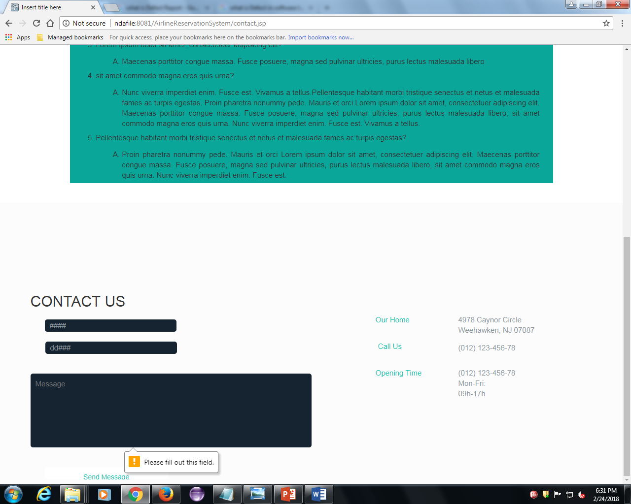
DEFECTS FOUND Cont..

Slide 20
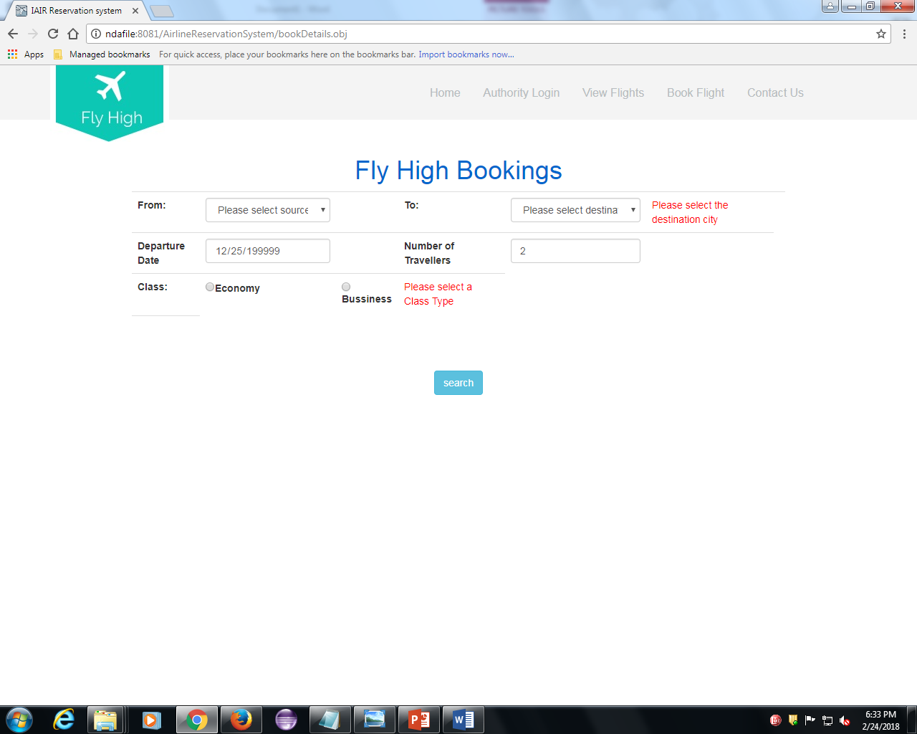
DEFECTS FOUND Cont..

Slide 21
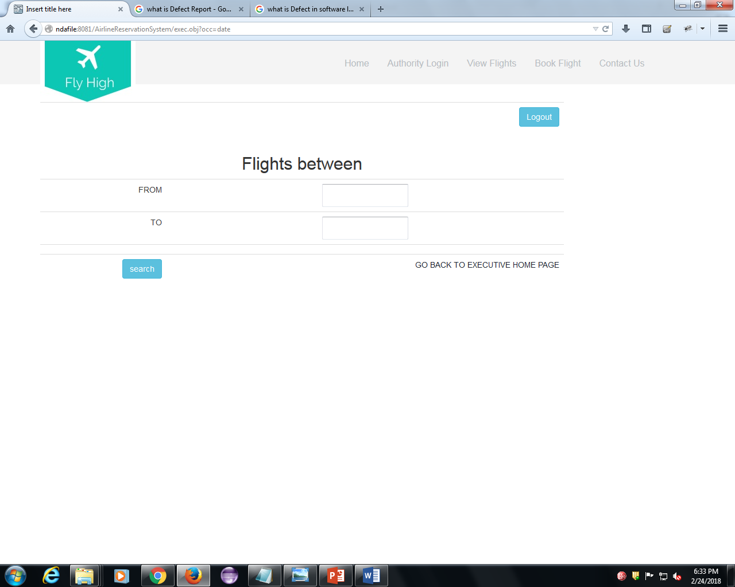
DEFECTS FOUND Cont..

Slide 22
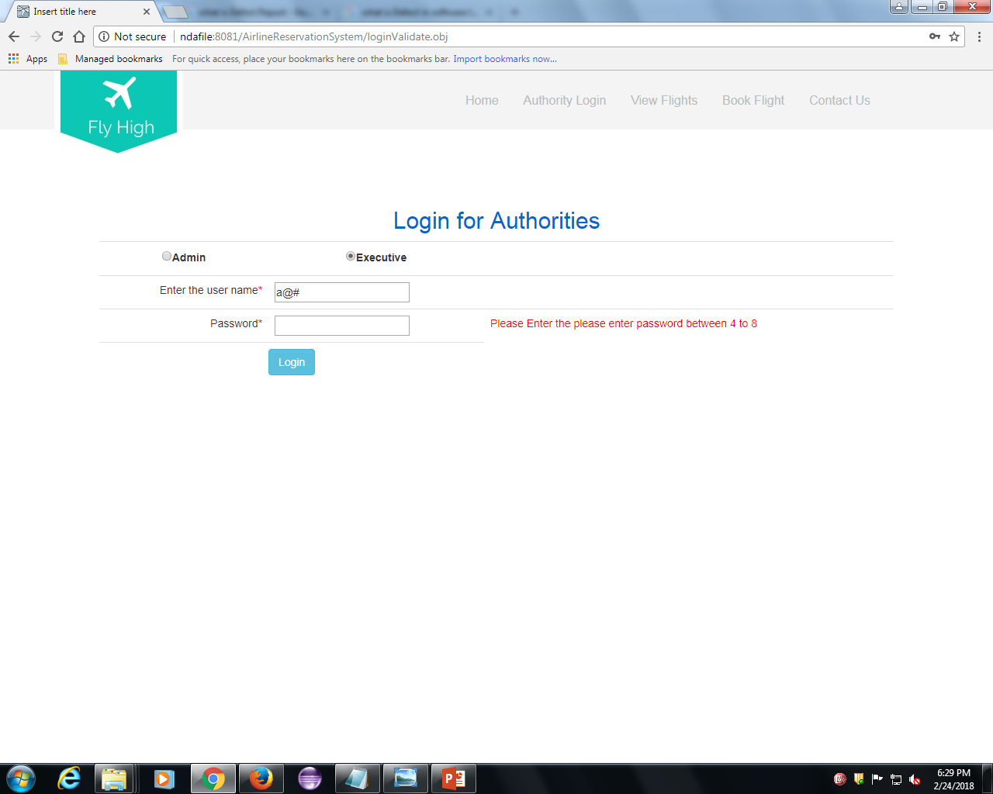
DEFECTS FOUND Cont..

Slide 23
Test Summary
Tested in brief
We have tested the functionalities of Manager login, Admin login, Manager view asset, Manager view requested asset, Admin add asset, Admin View Asset, Admin Update Asset, Admin delete Asset , Admin view requested asset .
TestCases
Total No. of Testcases = 104
Total No. of test cases passed = 38
Total No. of Test cases failed =66
Defects
Total No. of defects found =66
Usecases
Total no. of flows = 12
People Worked
No. of People worked in this project = 6.

Slide 24
Metrics Calculation
Test Case Effectiveness :
This metrics define the effectiveness of the test cases which is measured in terms of the number of defects found in testing with using the test cases.
Test Case Effectiveness = No of defects detected using test cases*100/total no of test cases
=(66*100)/104
=63.4%

Slide 25
Continuation..
Test Case Adequacy :
This metrics defines the number of actual test cases created vs. the estimated test cases at the end of the test case preparation phase
Test Case Adequacy = No. of actual Test cases*100/No of test cases estimated
=(104*100)/150
=69.3%

Slide 26
Traceability Matrix
DFDR ID | Test Case ID | Requirement ID
DF_AdminUpdate_001 | TC_AdminUpdate_02 | REQ_AdminUpdate_054
DF_AdminUpdate_002 | TC_AdminUpdate_03 | REQ_AdminUpdate_055
DF_AdminUpdate_003 | TC_AdminUpdate_04 | REQ_AdminUpdate_056
DF_AdminUpdate_004 | TC_AdminUpdate_05 | REQ_AdminUpdate_057
DF_AdminUpdate_005 | TC_AdminUpdate_06 | REQ_AdminUpdate_058
DF_AdminUpdate_006 | TC_AdminUpdate_07 | REQ_AdminUpdate_059
DF_AdminUpdate_007 | TC_AdminUpdate_08 | REQ_AdminUpdate_060
DF_AdminUpdate_008 | TC_AdminUpdate_09 | REQ_AdminUpdate_061
DF_AdminUpdate_009 | TC_AdminUpdate_10 | REQ_AdminUpdate_062
DF_AdminUpdate_010 | TC_AdminUpdate_12 | REQ_AdminUpdate_064
DF_AdminUpdate_011 | TC_AdminUpdate_13 | REQ_AdminUpdate_065
DF_AdminUpdate_012 | TC_AdminUpdate_14 | REQ_AdminUpdate_066

Slide 27
DFDR ID | Test Case ID | Requirement ID
DF_AdminDeleteAsset_001 | TC_AdminDelete_01 | REQ_AdminDelete_068
DF_AdminDeleteAsset_002 | TC_AdminDelete_02 | REQ_AdminDelete_069
DF_AdminDeleteAsset_003 | TC_AdminDelete_03 | REQ_AdminDelete_070
DF_AdminDeleteAsset_004 | TC_AdminDelete_04 | REQ_AdminDelete_071
DF_AdminDeleteAsset_005 | TC_AdminDelete_05 | REQ_AdminDelete_072
DF_AdminDeleteAsset_006 | TC_AdminDelete_06 | REQ_AdminDelete_073
DF_AdminViewRequsted_001 | TC_AdminViewRequested_001 | REQ_AdminViewRequested_074
DF_AdminViewRequsted_002 | TC_AdminViewRequested_002 | REQ_AdminViewRequested_075
DF_ManagerHomePage_001 | TC_ManagerHomePage_003 | REQ_ManagerHomePage_079
DF_ManagerHomePage_002 | TC_ManagerHomePage_004 | REQ_ManagerHomePage_080
DF_ManagerHomePage_003 | TC_ManagerHomePage_005 | REQ_ManagerHomePage_081

Slide 28
DFDR ID | Test Case ID | Requirement ID
DF_Manager_RequestAsset_001 | TC_Manager_RequestAsset_001 | REQ_ManagerRequestAsset_082
DF_Manager_RequestAsset_002 | TC_Manager_RequestAsset_002 | REQ_ManagerRequestAsset_083
DF_Manager_RequestAsset_003 | TC_Manager_RequestAsset_003 | REQ_ManagerRequestAsset_084
DF_Manager_RequestAsset_004 | TC_Manager_RequestAsset_004 | REQ_ManagerRequestAsset_085
DF_Manager_RequestAsset_005 | TC_Manager_RequestAsset_005 | REQ_ManagerRequestAsset_086
DF_Manager_RequestAsset_006 | TC_Manager_RequestAsset_015 | REQ_ManagerRequestAsset_096
DF_Manager_RequestAsset_007 | TC_Manager_RequestAsset_006 | REQ_ManagerRequestAsset_087
DF_Manager_RequestAsset_008 | TC_Manager_RequestAsset_007 | REQ_ManagerRequestAsset_088
DF_Manager_RequestAsset_009 | TC_Manager_RequestAsset_008 | REQ_ManagerRequestAsset_089
DF_Manager_RequestAsset_010 | TC_Manager_RequestAsset_009 | REQ_ManagerRequestAsset_090
DF_Manager_RequestAsset_011 | TC_Manager_RequestAsset_014 | REQ_ManagerRequestAsset_095

Slide 29
DFDR ID | Test Case ID | Requirement ID
DF_Manager_RequestAsset_012 | TC_Manager_RequestAsset_010 | REQ_ManagerRequestAsset_091
DF_Manager_RequestAsset_013 | TC_Manager_RequestAsset_011 | REQ_ManagerRequestAsset_092
DF_Manager_RequestAsset_014 | TC_Manager_RequestAsset_012 | REQ_ManagerRequestAsset_093
DF_Manager_RequestAsset_015 | TC_Manager_RequestAsset_016 | REQ_ManagerRequestAsset_097
DF_Manager_RequestAsset_016 | TC_Manager_RequestAsset_017 | REQ_ManagerRequestAsset_098
DF_ManagerViewRequsted_001 | TC_ManagerViewRequested_01 | REQ_ManagerViewRequested_100
DF_ManagerViewRequsted_002 | TC_ManagerViewRequested_02 | REQ_ManagerViewRequested_101
DF_ManagerViewRequsted_003 | TC_ManagerViewRequested_03 | REQ_ManagerViewRequested_102
DF_ManagerViewRequsted_004 | TC_ManagerViewRequested_04 | REQ_ManagerViewRequested_103

Slide 30
Q & A

Slide 31
Thank YOU!!

